Slide 1
Final Project – JES Checkers
Bijan – Erik – John - Levi

Slide 2
Objective
Build a fully-functional checkers game in Python that utilizes visual and auditory manipulations to enhance the experience.

Slide 3
Approach
We approached this project with an Agile Software Development Methodology.
Multiple functions were operated on concurrently, and iterations were frequently pushed out with slight additions or bug fixes.
Consistent and clear communication guided the entire breadth of the project.

Slide 4
Member Responsibilities
Erik: Visual foundation & draw functions
Levi: Command processing & sound design
Bijan: Core game logic & debugging
John: Additional game logic & debugging

Slide 5
Results
Erik: The board and game pieces are drawn using built-in JES functions
Levi: The game is initiated and user is prompted for string. String is analyzed and translates to game piece movement
Bijan - John: Game piece movement is determined valid via a series of logical checks according to Checkers game rules

Slide 6
Results (cont…)
Erik: Last 10 moves are displayed to the screen
John, Bijan, Levi: Logic checks & string processing debugged & improvedCollage of sound is constructed and played to speak movements as they occur - Levi
John: King functionality & improved file handling

Slide 7
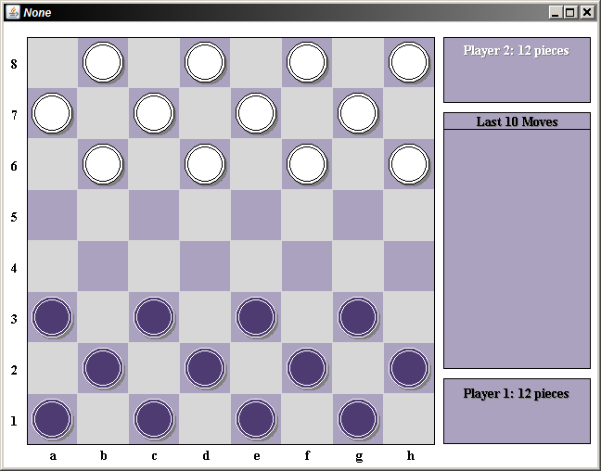
Default game board before activity

Slide 8
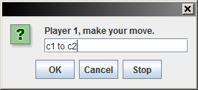
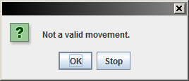
Commands for movement are checked for validity

Slide 9
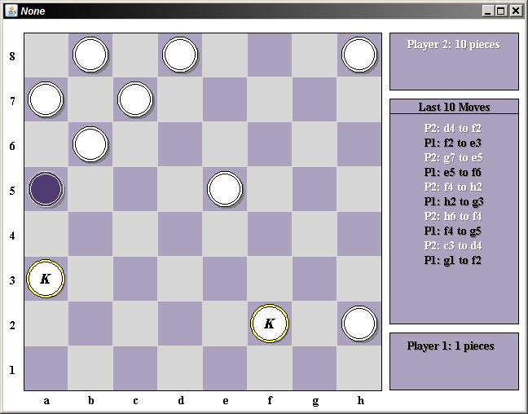
Game board with updated move list, piece totals per player, and King pieces

Slide 10
Things Learned
Bijan:
Python programming language
working remotely with a team on a programming project
working with sounds and image processing/general multimedia programming
John:
The code behind multimedia and how to manipulate that code
Fundamentals of the Python language
introduction to a dynamically written programming language

Slide 11
Things Learned (cont…)
Erik:
Python syntax and style
drawing graphics with code
peer programming methods and benefits
Levi:
Python list and dictionary manipulation + string splicing in service of user-string processing
Debugging
peer programming methodologies

Slide 12
Group Status Google Doc
https://docs.google.com/document/d/1n07UuCKFWx_oVk6hyPhlz1JQqdnd6TXbrk8bcBR7_OQ/edit

